Slide 2
Cross word
7
F A I R Y
1
F
A
B
L
E
S
2
G I A N T
3
B U D D H A
4
E V I L
5
E M P E R O R
6
P R I N C E S S

Slide 3
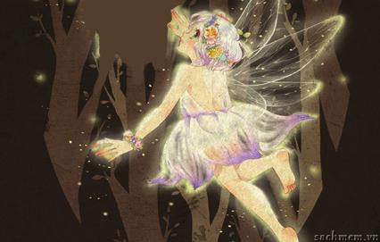
What a beautiful _______!

Slide 4
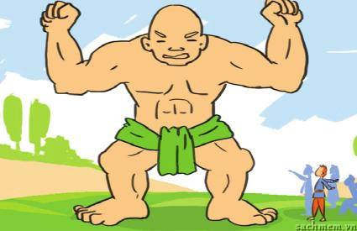
How strong the_______ is!

Slide 5
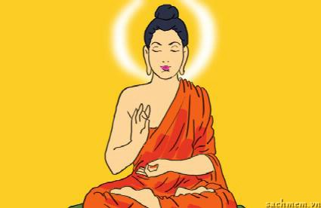
How kind the _______ is!

Slide 6
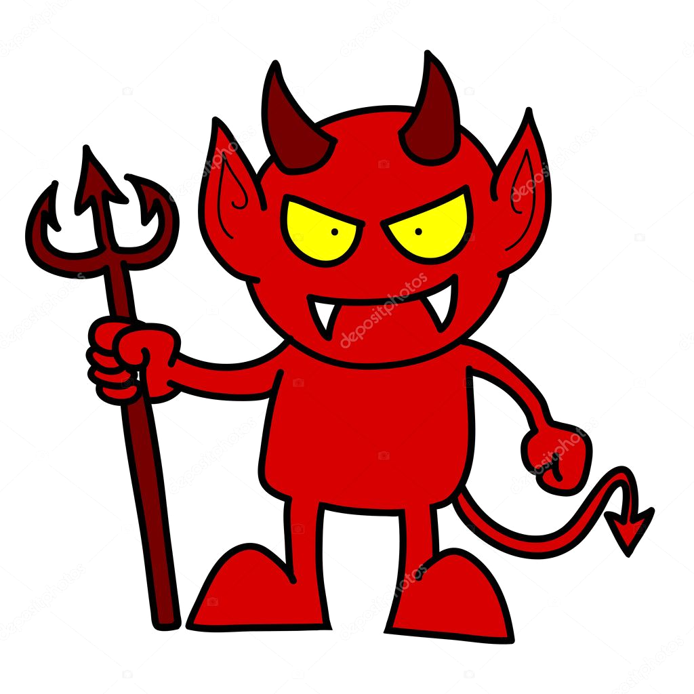
What a wicked______!

Slide 7
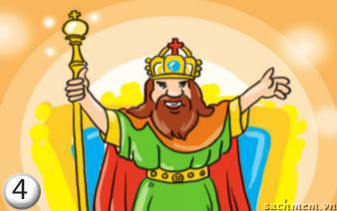
How rich the _______ is!

Slide 8
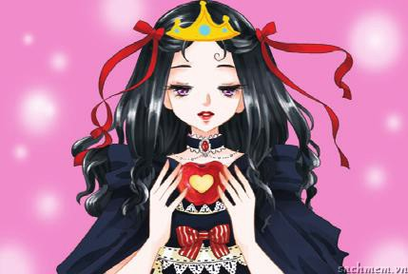
What a gorgeous ______!

Slide 9
Tuesday, 14th December 2021
UNIT 6. FOLK TALES
Period 43. Lesson 2.
A closer look 1

Slide 10
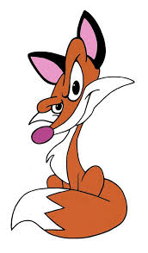
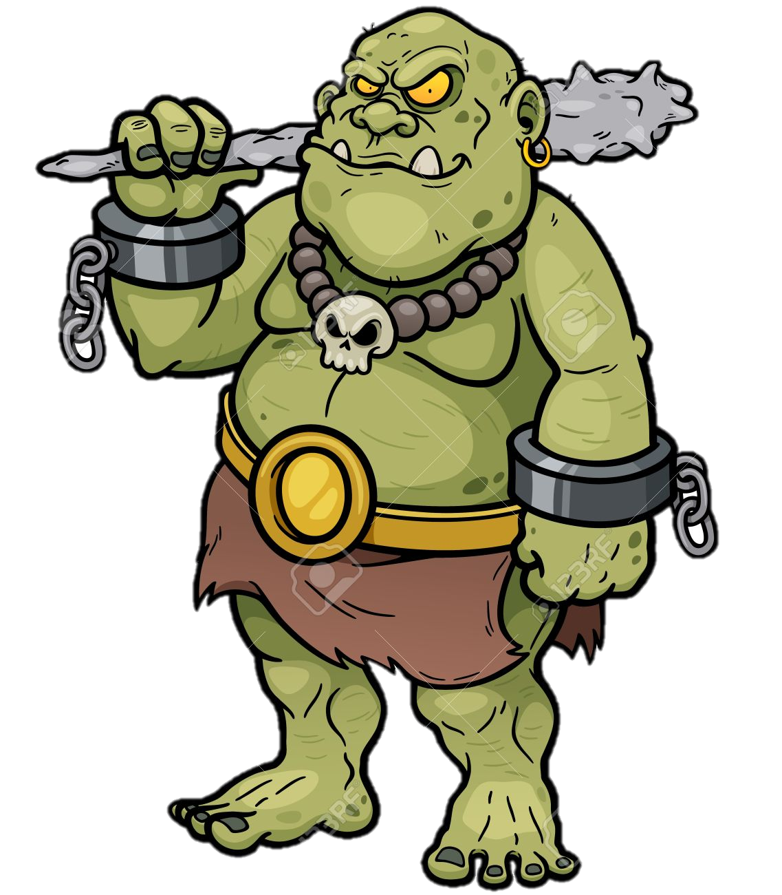
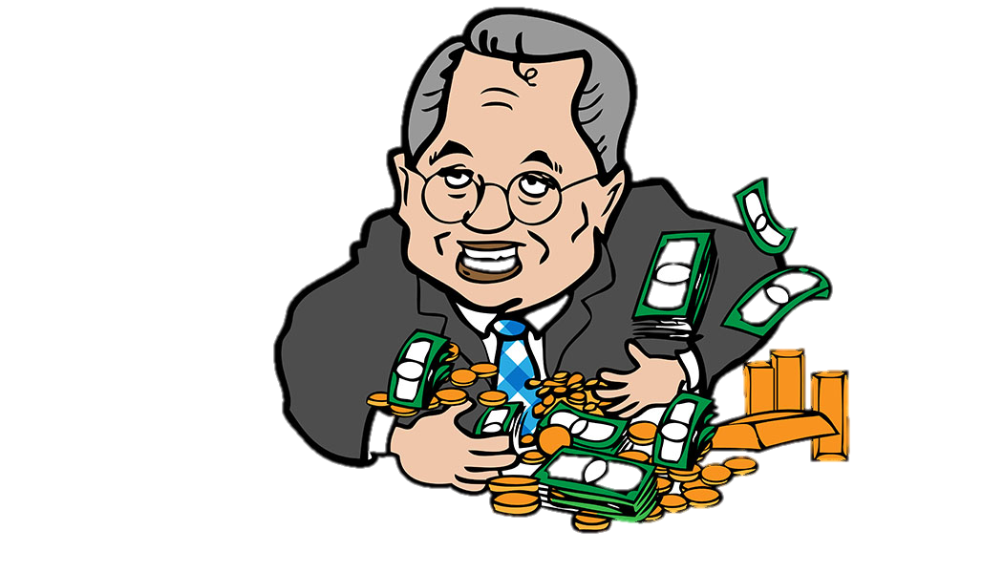
I. New words
ogre (n)
/ˈoʊɡɚ/
greedy (a)
/ˈɡri:di/
cunning (a)
/ˈkʌnɪŋ/
Yêu tinh
Tham lam
Xảo quyệt

Slide 11
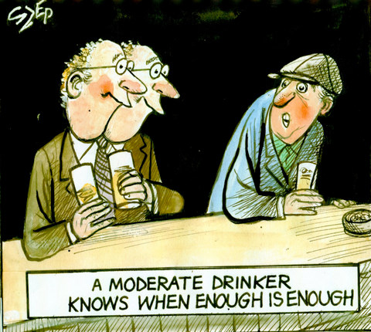
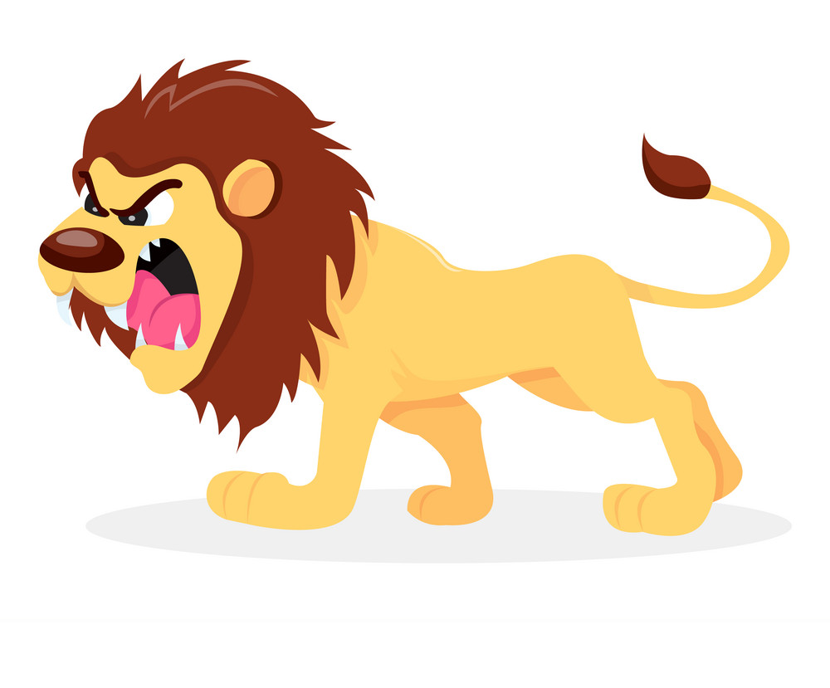
I. New words
fierce/fɪəs/ (a)
moderate (a)
/ˈmɒdərət/
Hung dữ
Điều độ, ôn hòa

Slide 12
I. New words
- ogre/ˈoʊɡɚ (n)
Yêu tinh
- greedy/ˈɡri:di/ (a)
Tham lam
- cunning /ˈkʌnɪŋ/ (a)
Xảo quyệt
- fierce/fɪəs/ (a)
Hung dữ
- moderate/ˈmɒdərət/ (a)
Điều độ, ôn hòa

Slide 13
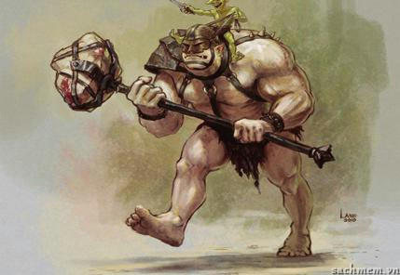
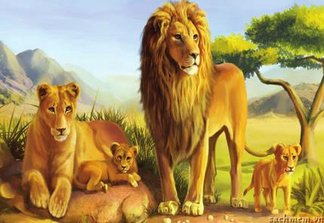
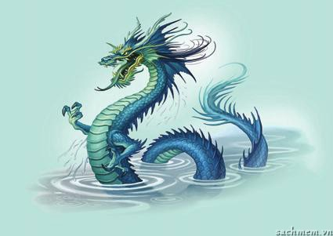
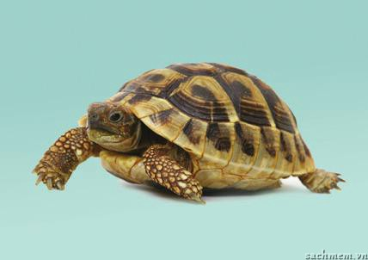
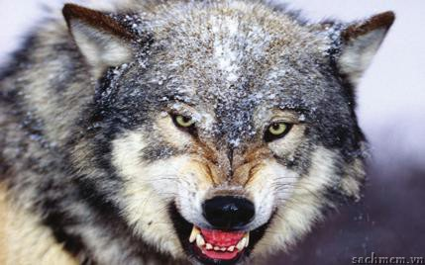
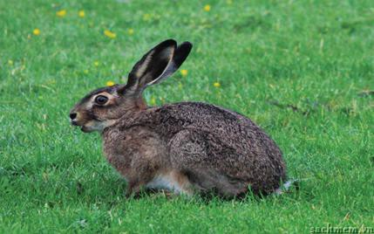
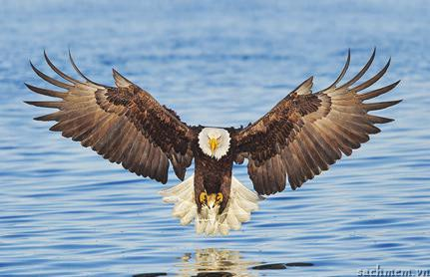
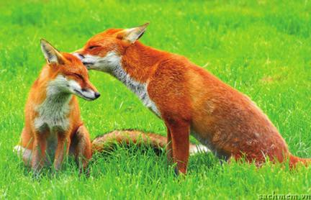
Label the pictures
dragon B. wolf C. hare D. fox
E. tortoise F. lion G. ogre H. eagle
dragon
3________
4________
ogre
2________
tortoise
1________
lion
wolf
fox
5________
hare
eagle
8________
6________
7________

Slide 14
Complete the table
cheerful generous greedy mean
evil cunning wicked kind
fierce cruel brave
Positive | Negative
cheerful
generous
brave
kind
cruel
mean
evil
greedy
wicked
fierce
cunning

Slide 15
Describe a character you like
What a cunning fox it is!

Slide 16
II. Pronunciation:
Listen and repeat
1.What a colorful hat she is wearing!
2.What a time we’ve had today!
3.What beautiful eyes she has!
4.What a nice day it is!
5.What good news it is!

Slide 17
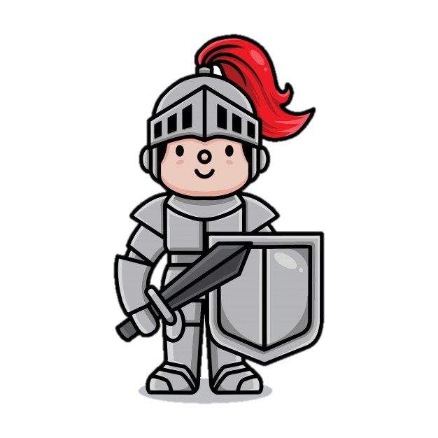
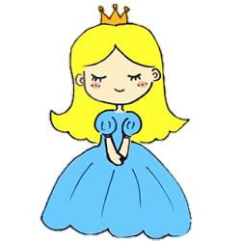
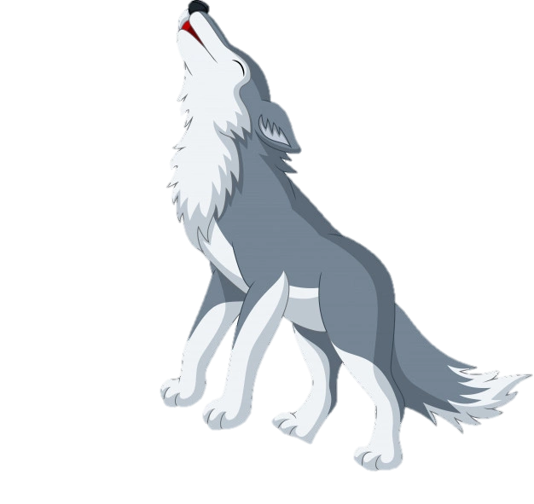
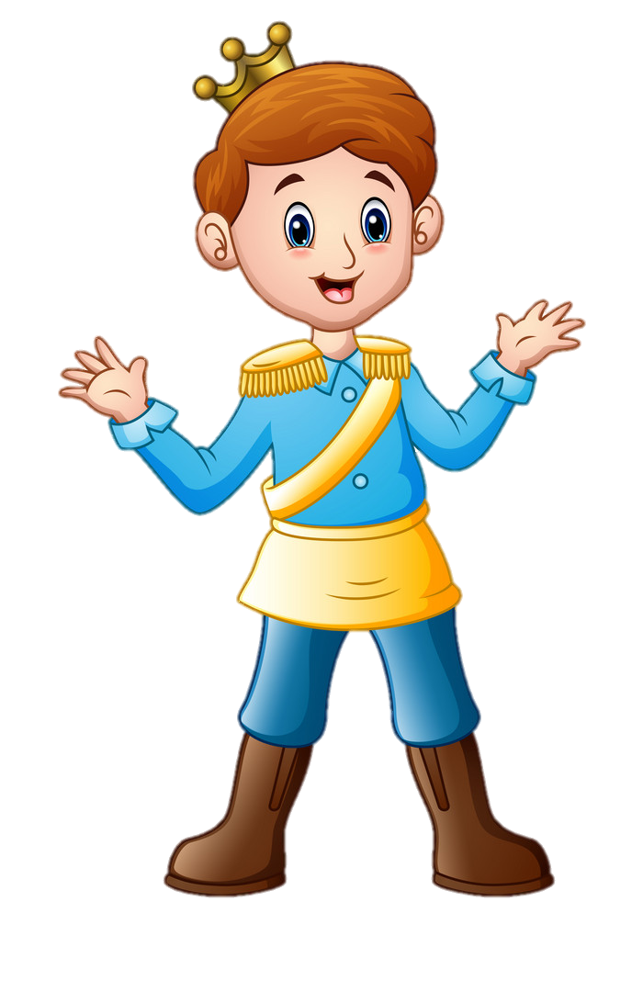
II. Pronunciation:
Listen and repeat
1.What a beautiful princess she is!
2.What brave knights they are!
3.What a big nose the wolf has!
4.What a fierce ogre it is!
5.What a handsome prince he is!

